Slide 1
Wildfire Simulation using Cellular Automaton
Sarvar Abdullaev

Slide 2
Outline
What is Cellular Automaton?
Computing using Cellular Automaton
Modelling Nature using Cellular Automaton
Self-organization in Cellular Automaton
Differential Cellular Automaton (DCA)
PyTorchFire: DCA based Wildfire Simulator
Lab: Training and running simulation using PyTorchFire

Slide 3
What is Cellular Automaton?

Slide 4
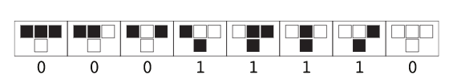
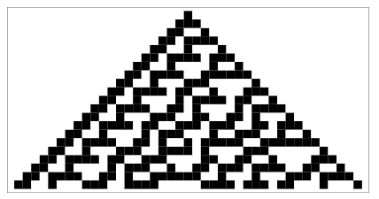
1D Elementary Cellular Automaton

Slide 5
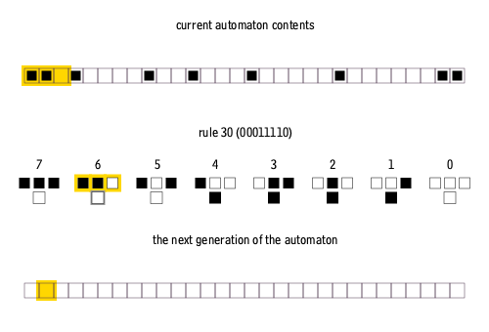
1D Elementary Cellular Automaton

Slide 6
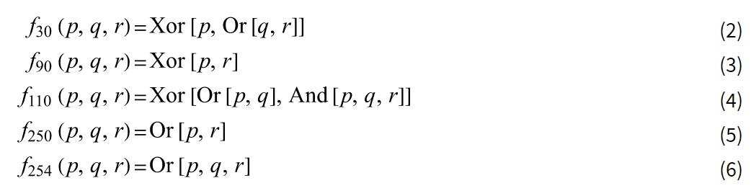
Rules as Boolean Functions

Slide 7
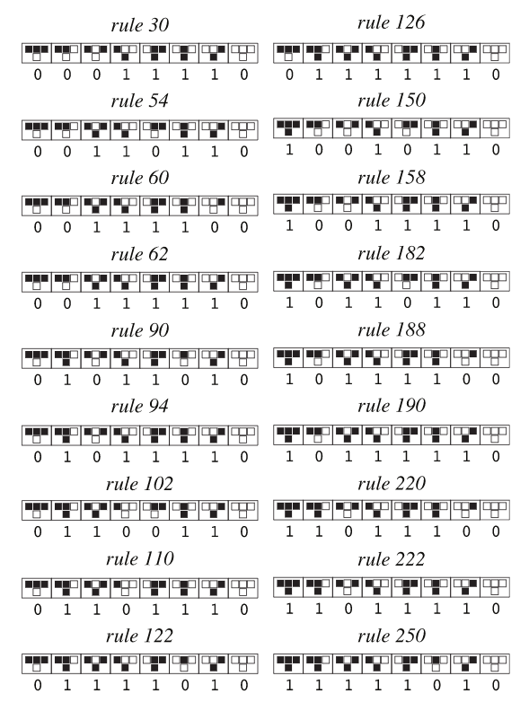
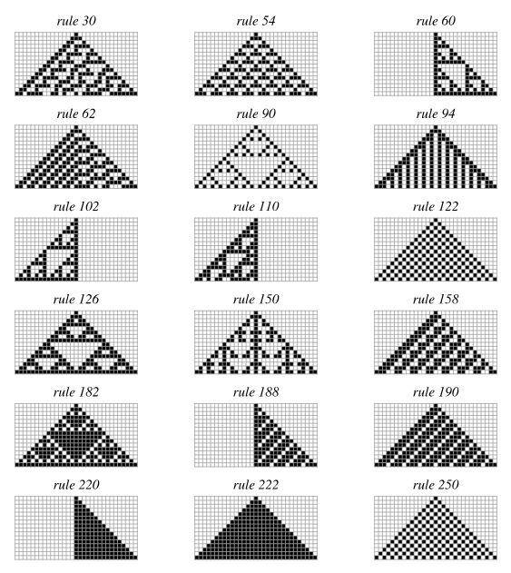
1D Elementary Cellular Automaton

Slide 8
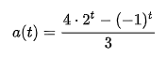
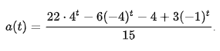
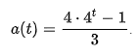
Single 1 Histories
Rule 28:
1, 3, 5, 11, 21, 43, …
Rule 50:
1, 5, 21, 85, 341, 1365,…
Rule 54:
1, 7, 17, 119, 273, 1911, 4369,…
Rule 60:
1, 3, 5, 15, 17, 51, 85, 255
Sierpinski triangle
Rule 90:
1, 5, 17, 85, 257, 1285
Pascal’s triangle mod 2

Slide 9
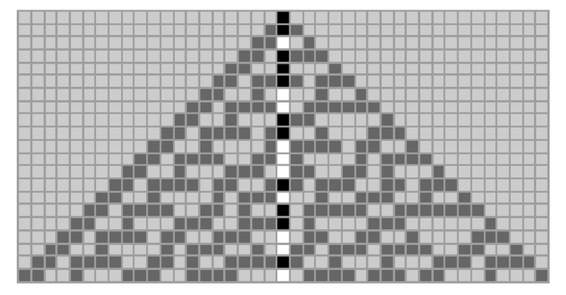
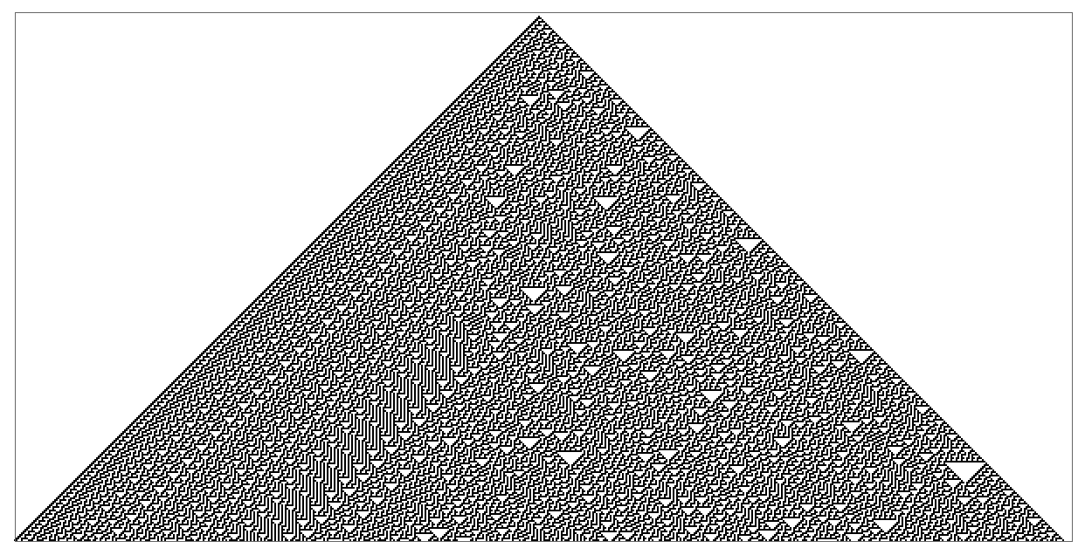
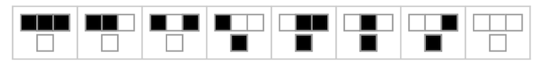
Rule 30 - Challenge
The Wolfram Foundation is offering $30,000 in prize money for correct solutions of these problems:
Problem 1:
Does the center column always remain non-periodic?
Problem 2:
Does each color of cell occur on average equally often in the center column?
Problem 3:
Does computing the nth cell of the center column require at least O(n) computational effort?
Rule 30

Slide 10
Random Initial State
Class 1: Converge to a uniform state
Rules 0, 32, 160
Class 2: Converge to a repetitive or stable state
Rules 4, 108, 218 and 250
Class 3: Remain in random state
Rules 22, 30, 126, 150, 182
Class 4: Has stable and repetitive regions which can interact with each other in complicated ways
Rules 110 – capable of universal computation
Rule 62 starts as Class 4 and one structure annihilates the other and repeats

Slide 11
Computing using CA

Slide 12

Game of Life – 2D totalistic CA
Any live cell with two or three live neighbors survives.
Any dead cell with three live neighbors becomes a live cell.
All other live cells die in the next generation. Similarly, all other dead cells stay dead.
Let’s play:
https://playgameoflife.com/

Slide 13
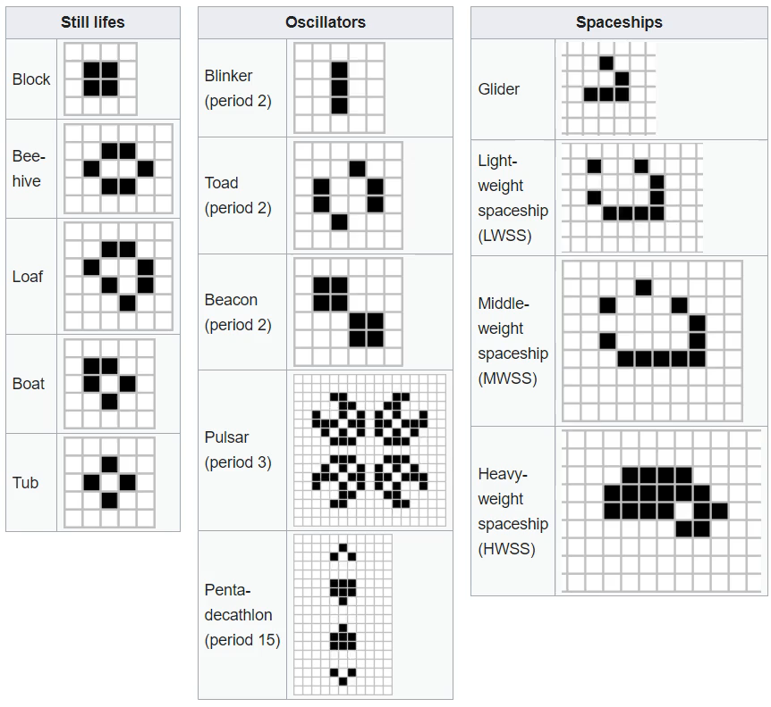
Game of Life - Zoo

Slide 14
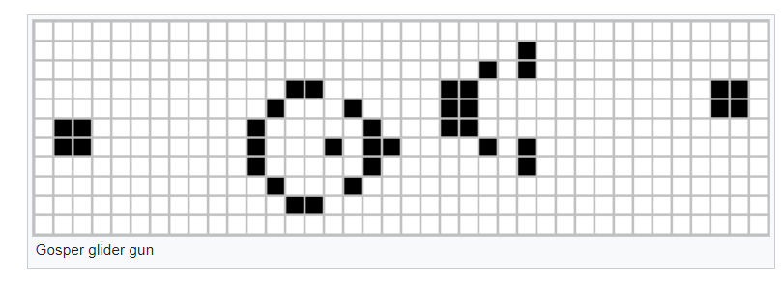
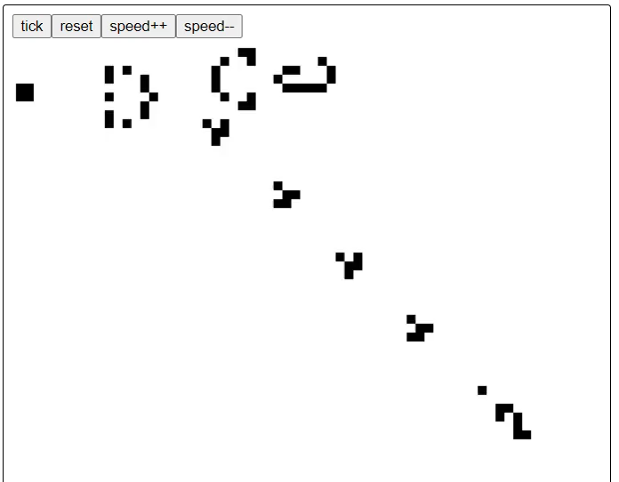
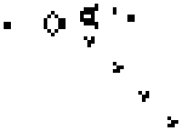
Game of Life – Generating/Blocking Signals
Gospel’s glider gun
Generating signals
Blocking signals

Slide 15
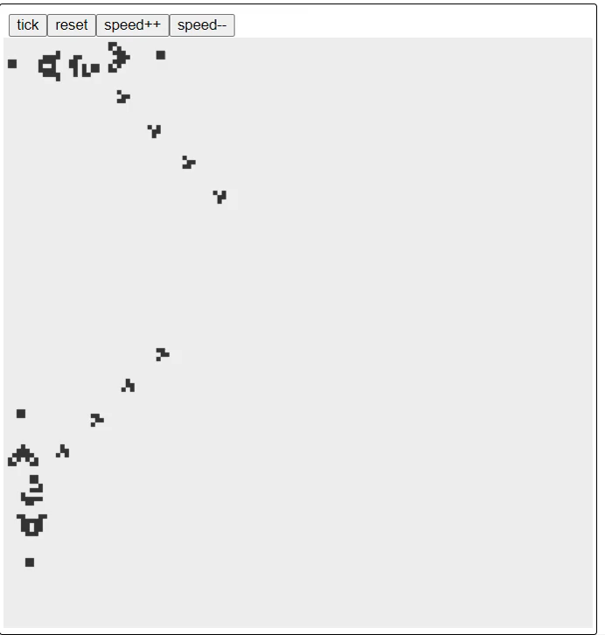
Game of Life - Collisions

Slide 16
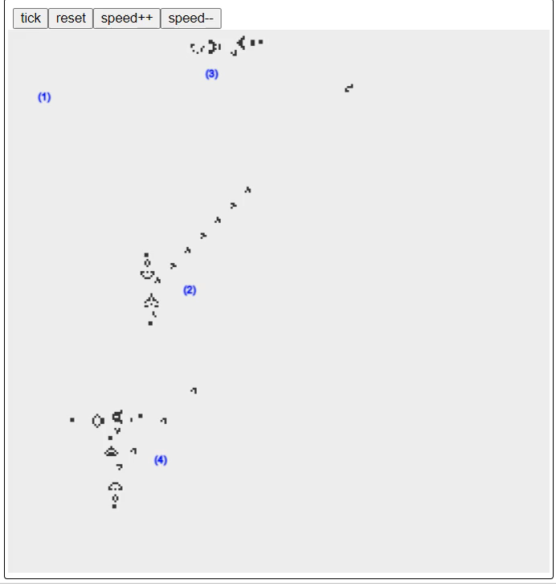
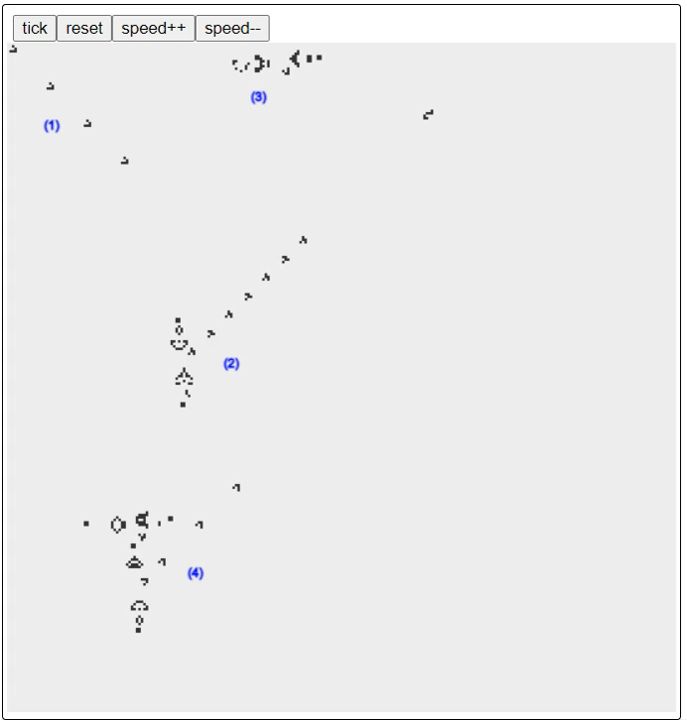
Game of Life – NOT gate
(1) is false, (4) is true
(1) is true, (4) is false

Slide 17
Game of Life – Turing Compete
We can also implement AND and OR gates in Game of Life (GoL)
https://nicholas.carlini.com/writing/2020/digital-logic-game-of-life.html
Glider guns and glider streams are key building blocks:
by arranging them appropriately, one can encode information flow and construct arbitrary logic circuits.
GoL is Turing Complete:
It can simulate any computation that a universal Turing machine can perform, given enough space and time.
It illustrates how simple local rules can yield arbitrarily complex global computation.

Slide 18
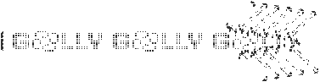
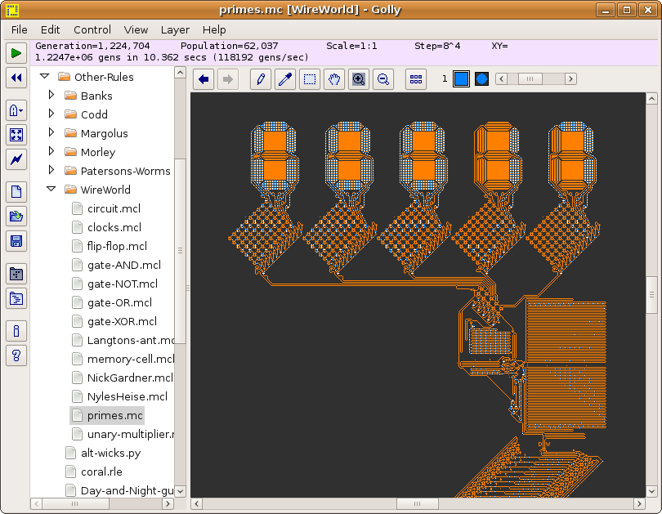
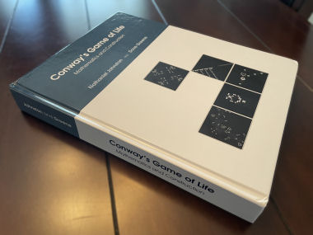
CA Programming Language
Golly (https://golly.sourceforge.io)
https://conwaylife.com/book

Slide 19
Modelling Nature using CA

Slide 20
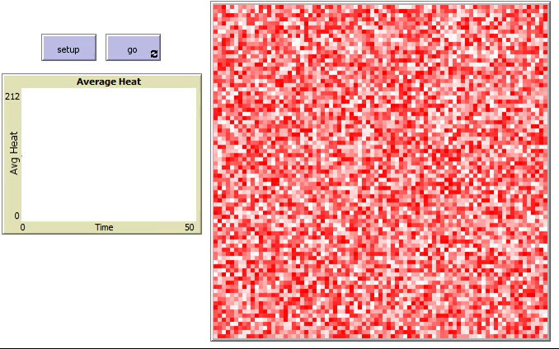
Heat Transfer and Boiling
This simulation depicts a simple cellular automata model that resembles a pot of boiling water.
Heat is applied evenly to the entire pot, but:
If all of a cell’s neighbors are at the maximum value of 212, then that cell’s new value will be zero.
At the next tick, the presence of this zero-valued cell will lower the values of the cell’s nearest neighbors.
This process is analogous to the way in which a hot enough region of water gives up some heat by forming a bubble of steam.
Source: Wilensky, U. (1999). NetLogo. http://ccl.northwestern.edu/netlogo/.
Center for Connected Learning and Computer-Based Modeling, Northwestern University, Evanston, IL.

Slide 21

River Meanders
This model demonstrates the meandering of a river along its “middle course”
There are three main parts:
Land patches – a place where there is no flow
Water – a place where there is a flow
Flow – moving particle that cause deposition and erosion.
Flow moves according to flow gradient.
Erosion:
When Flow collides with Land, it “erodes” the Land tile into Water tile
Deposition:
Every time tick, 1% sediment is deposited to Water.
Water tile turns to Land tile if its sediment is 100%
Flow washes away sediment by 15% in Water tile.
If there is no Flow in Water, it gradually turns into Land.
Source: Caldeira, F. and Wilensky, U. (2021). NetLogo River Meanders model.
http://ccl.northwestern.edu/netlogo/models/RiverMeanders.
Center for Connected Learning and Computer-Based Modeling, Northwestern University, Evanston, IL.

Slide 22
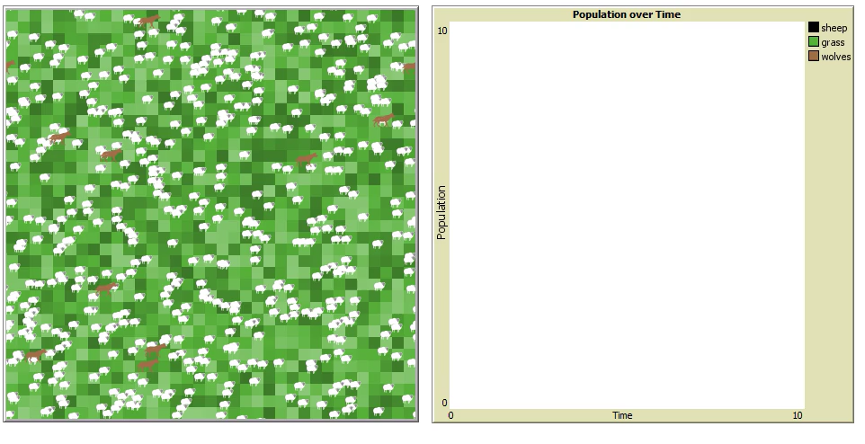
Predator Prey Dynamics
The model creates a population of Sheep that wander around the landscape
For each step the Sheep take it costs them some energy and if there energy gets too low they die.
However, the Sheep can eat Grass in the environment to regain energy and the Grass regrows over time.
If the energy of the Sheep gets above a certain level then they can reproduce.
Wolves have the same behaviors as Sheep except for eating; rather than Grass, they eat Sheep.
Source: Wilensky, U. (2007). NetLogo Wolf Sheep Simple 5 model.
http://ccl.northwestern.edu/netlogo/models/WolfSheepSimple5.
Center for Connected Learning and Computer-Based Modeling, Northwestern Institute on Complex Systems,
Northwestern University, Evanston, IL.

Slide 23
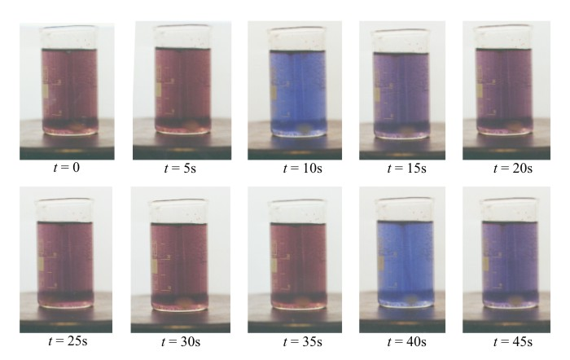
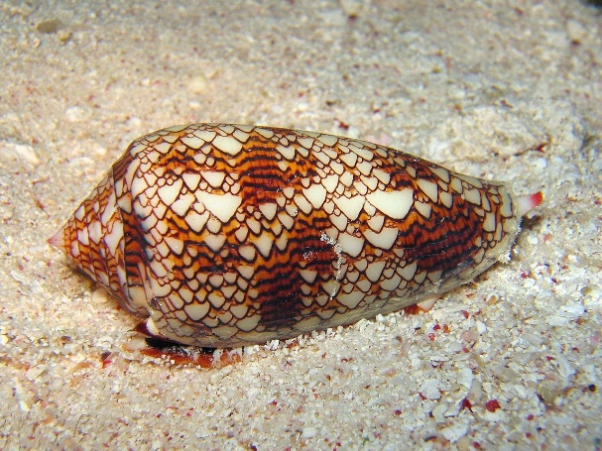
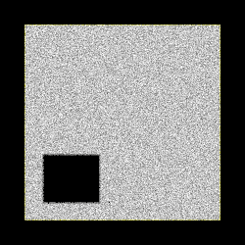
And Many More…
Conus textile exhibits
a cellular automaton pattern on its shell
Simulation of fluid flows at micro-level,
described by Navier-Stokes equations at macro-level
A stirred BZ reaction mixture showing changes in color over time

Slide 24
Differential Cellular Automaton

Slide 25
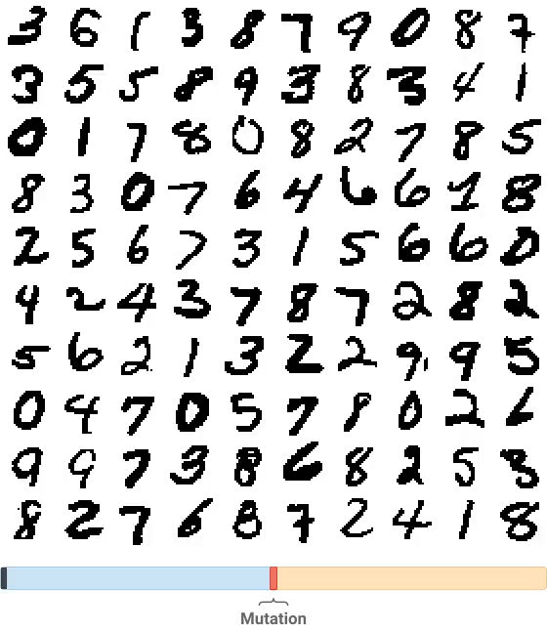
Differential Cellular Automaton
Cell states are not discrete, but continuous functions that usually represent some physical quantities
Analogous to PDEs used in natural sciences
ML models can learn the differential update rule directly from data, instead of handcrafted PDEs.
Source: Mordvintsev, A., Randazzo, E., et al (2020). Self-classifying MNIST Digits,
https://distill.pub/2020/selforg/mnist/

Slide 26

Self Organization in DCA
ML learns uniform rules for all cells and executes them in decentralized way.
Cells interact locally but collectively produce a coherent global structures.
System adapts and regulates itself
once the target pattern is reached, it maintains and even regenerate after damage
Source: Mordvintsev, A., Randazzo, E., et al (2020). Growing Neural Cellular Automata,
https://distill.pub/2020/growing-ca/

Slide 27
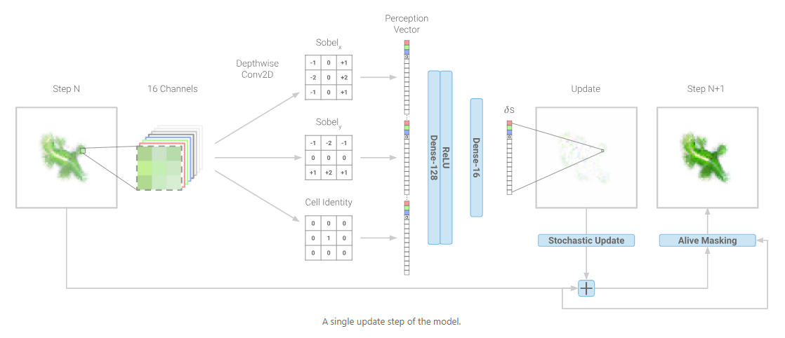
ML Model

Slide 28
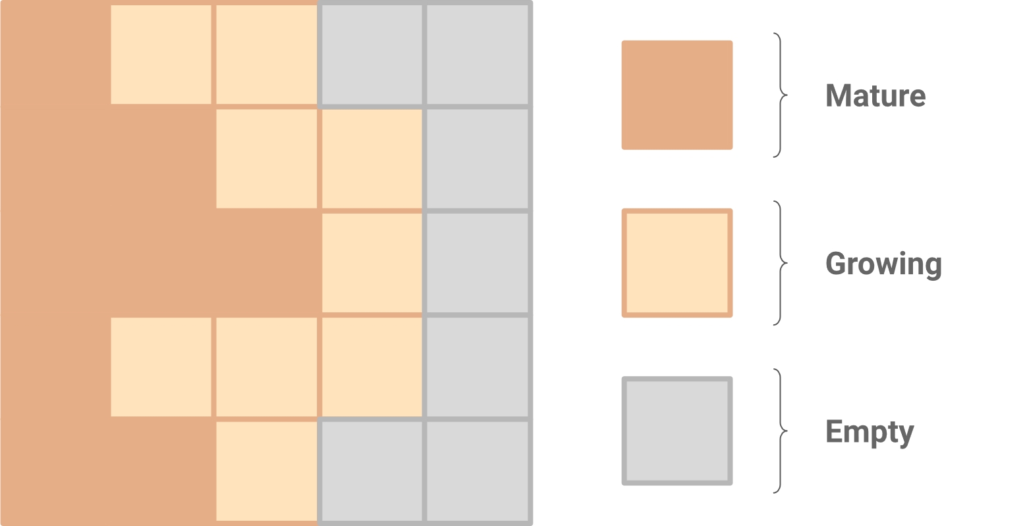
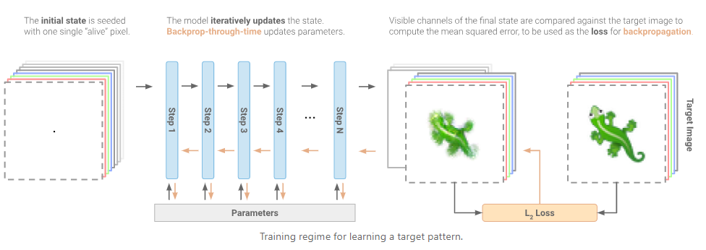
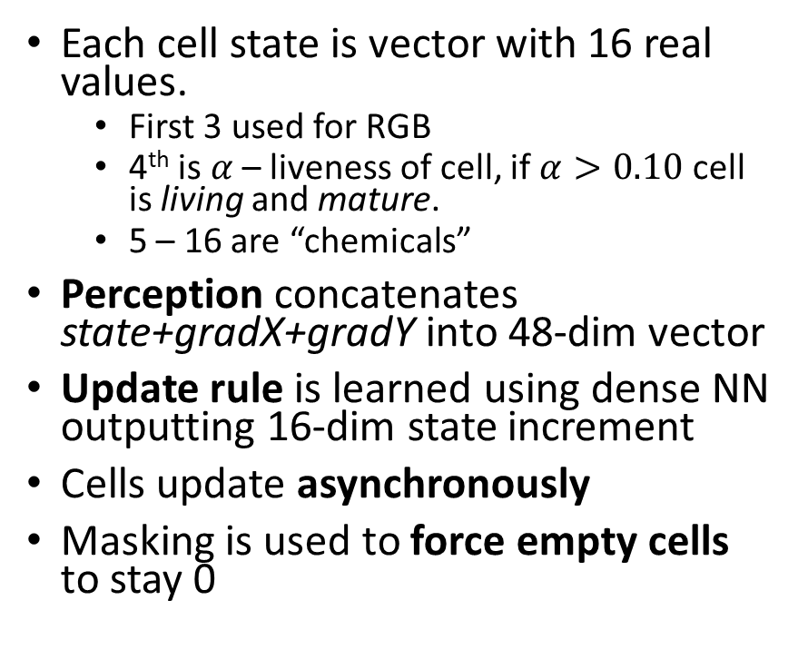
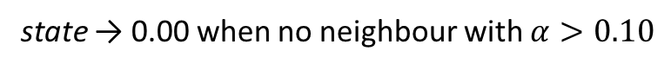
Cell State and CA rule
Each cell state is vector with 16 real values.
First 3 used for RGB
4th is $α$ – liveness of cell, if $α>0.10$ cell is living and mature.
5 – 16 are “chemicals”
Perception concatenates state+gradX+gradY into 48-dim vector
Update rule is learned using dense NN outputting 16-dim state increment
Cells update asynchronously
Masking is used to force empty cells to stay 0
state → 0.00 when no neighbour with $α>0.10$

Slide 29

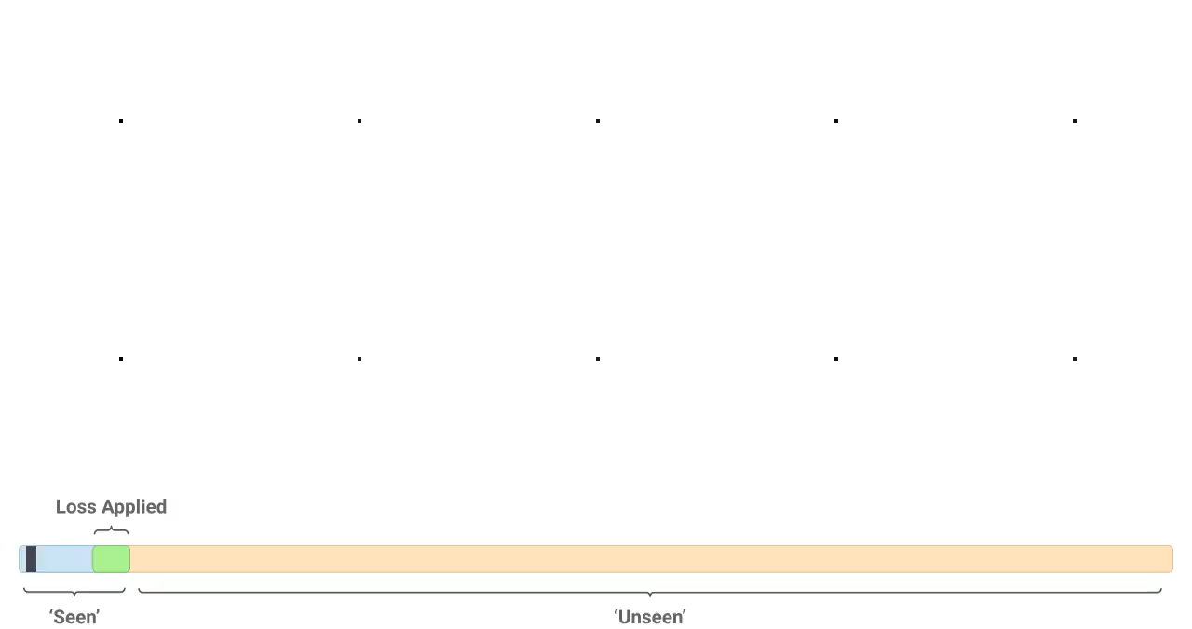

Fixing Instability Problem
Model learned to reach the target at time T from initial seed state.
But it didn’t know how to maintain itself
Pool of states were drawn from intermediate states and fed to model
Model learned how to reach the target from any of its evolutionary stages
Hence it learned to maintain itself.

Slide 30



Fixing Regeneration Problem
After a model has grown the target pattern from a seed and maintain its form, its ability to regenerate after damage was tested.
Some models without explicit training were able to recover
Models were randomly damaged with circular eraser and trained to regenerate.
Models could recover even from rectangular damage.

Slide 31
Key Takeaways
Local rules -> global structure
Complex patterns emerge from simple, shared, local update rules
Learnability
Update rule is learned via gradient descent
Self-organization and robustness
The system naturally develops stable attractors
No central controller
All behavior arises from decentralized, per-cell decisions
Interpretability of computation
Unlike black box deep NNs, DCAs expose internal structure and compact rules.
Mimicking natural processes
Gradient sensing, regeneration, growth from single seed, endemic characteristics
So, let’s put it
to some use, folks!

Slide 32
PyTorchFire: DCA based Wildfire Simulator

Slide 33
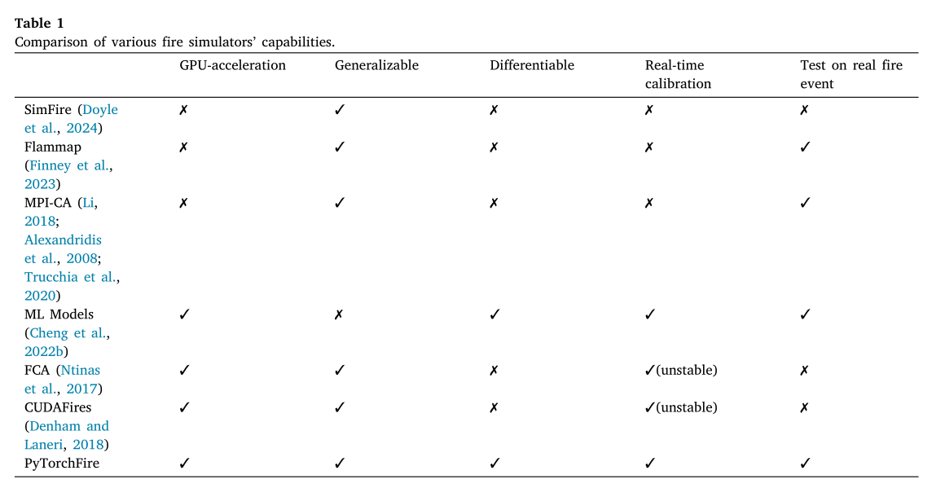
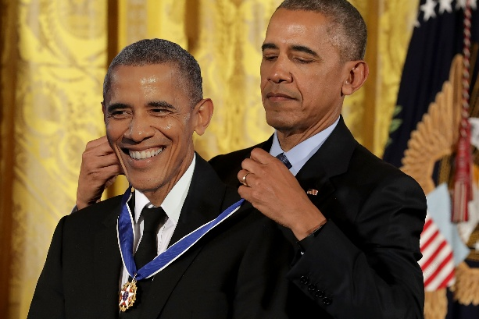
PyTorchFire: DCA based Wildfire Simulator
The U.S. sees ~60,000 unwanted wildfires per year, burning ~7 million acres annually.
Accurate early-stage predictions are crucial for firefighting, evacuation, and risk assessment.
Existing fire-spread models are too slow for real-time, high-resolution simulation.
ML surrogate models improve speed but do not generalize well across different ecoregions.

Slide 34
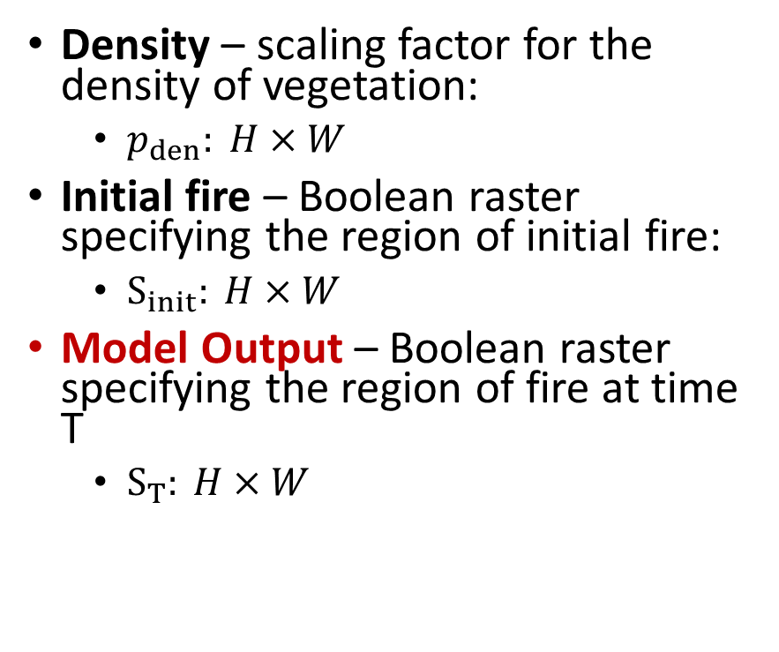
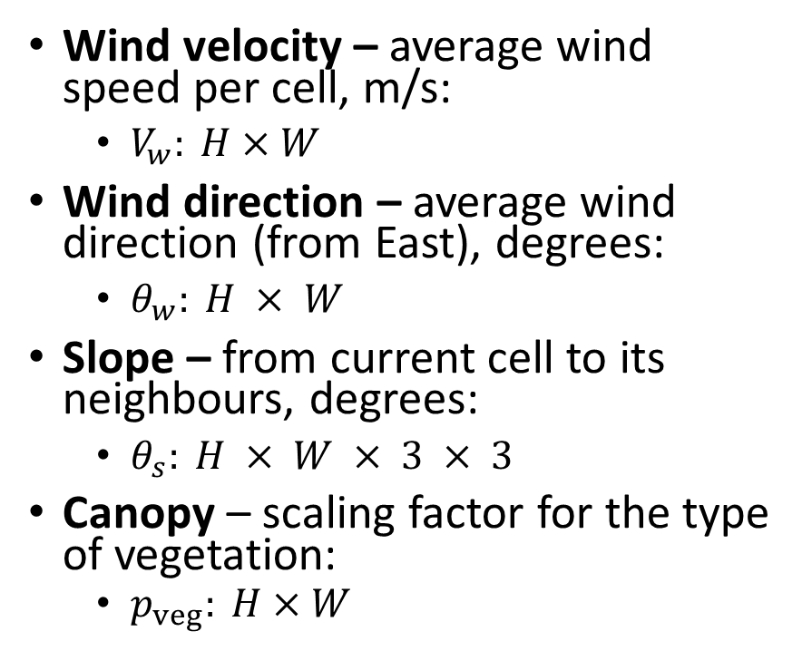
Model Inputs and Output
Wind velocity – average wind speed per cell, m/s:
$V_{w}: H×W$
Wind direction – average wind direction (from East), degrees:
$θ_{w}: H × W$
Slope – from current cell to its neighbours, degrees:
$θ_{s}: H × W × 3 × 3$
Canopy – scaling factor for the type of vegetation:
$p_{veg}: H×W$
Density – scaling factor for the density of vegetation:
$p_{den}: H×W$
Initial fire – Boolean raster specifying the region of initial fire:
$S_{init}: H×W$
Model Output – Boolean raster specifying the region of fire at time T
$S_{T}: H×W$

Slide 35
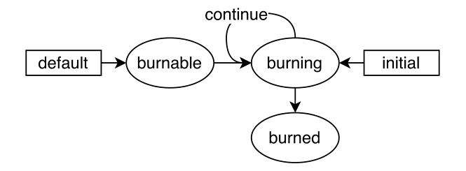
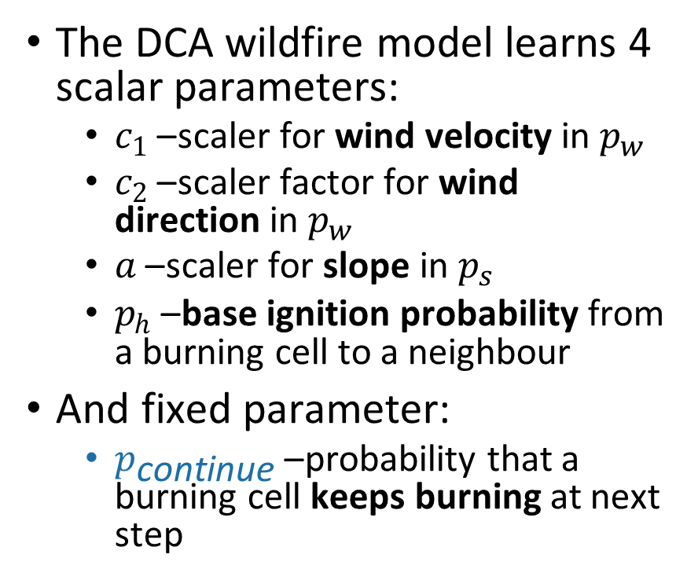



What model learns?
$$p_{\text{continue}}$$
The DCA wildfire model learns 4 scalar parameters:
$c_{1}$– scaler for wind velocity in $p_{w}$
$c_{2}$– scaler factor for wind direction in $p_{w}$
$a$– scaler for slope in $p_{s}$
$p_{h}$– base ignition probability from a burning cell to a neighbour
And fixed parameter:
$p_{\text{continue}}$– probability that a burning cell keeps burning at next step
$$p_{\text{ignite}}$$
$${1- p}_{\text{continue}}$$
Every cell in DCA follows this state transition diagram

Slide 36
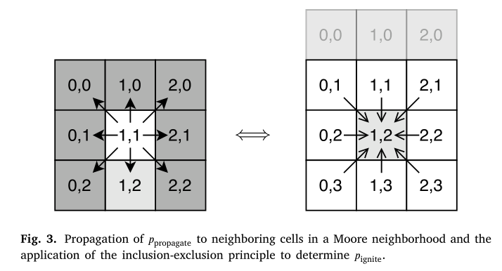
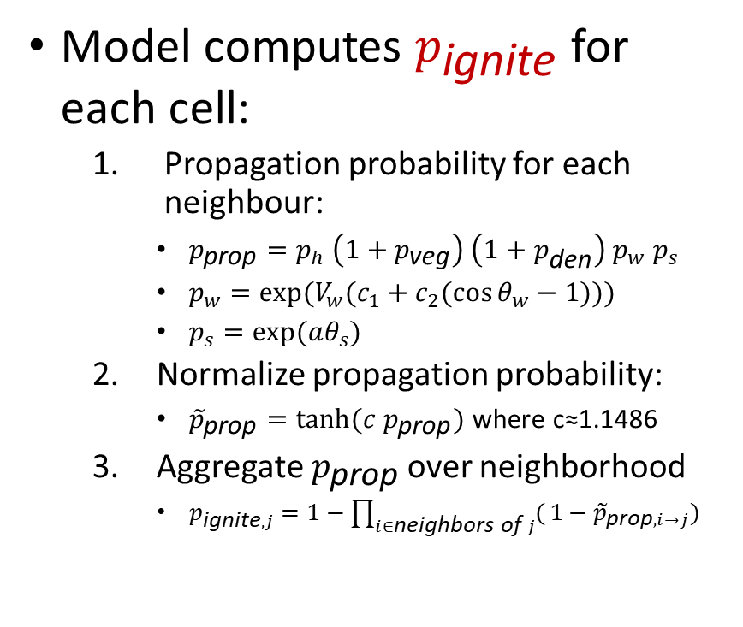
What model computes?
Model computes $p_{\text{ignite}}$ for each cell:
Propagation probability for each neighbour:
$p_{\text{prop}}=p_{h} \left(1+p_{\text{veg}}\right) \left(1+p_{\text{den}}\right) p_{w} p_{s}$
$p_{w}​=exp⁡({V_{w}(c}_{1}+c_{2}(\cos{θ_{w}−1))})$
$p_{s}​=exp⁡(aθ_{s})$
Normalize propagation probability:
${\tilde{p}}_{\text{prop}}={tanh⁡(c p}_{\text{prop}})$where c≈1.1486
Aggregate $p_{\text{prop}}$ over neighborhood
$p_{\text{ignite},j}=1−\prod_{i∈\text{neighbors} \text{of} j}{(}1−{\tilde{p}}_{\text{prop},i→j})$

Slide 37
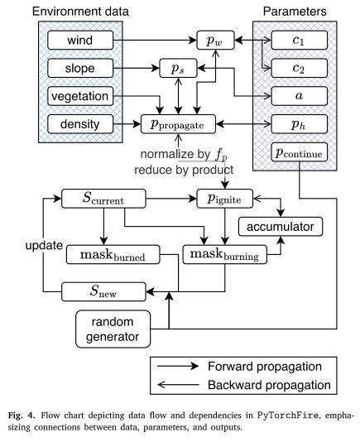
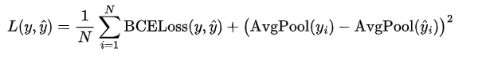
How model learns?
Model learns by minimizing loss function:
Autograd calculates gradients
AdamW optimizes 4 parameters

Slide 38
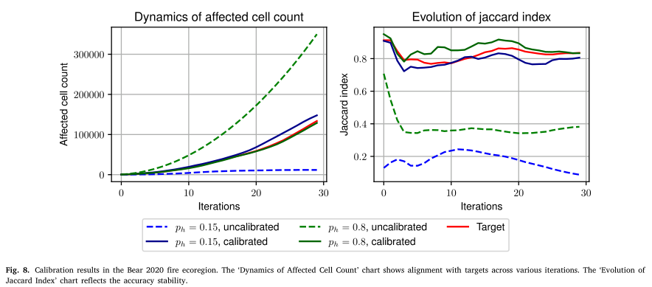
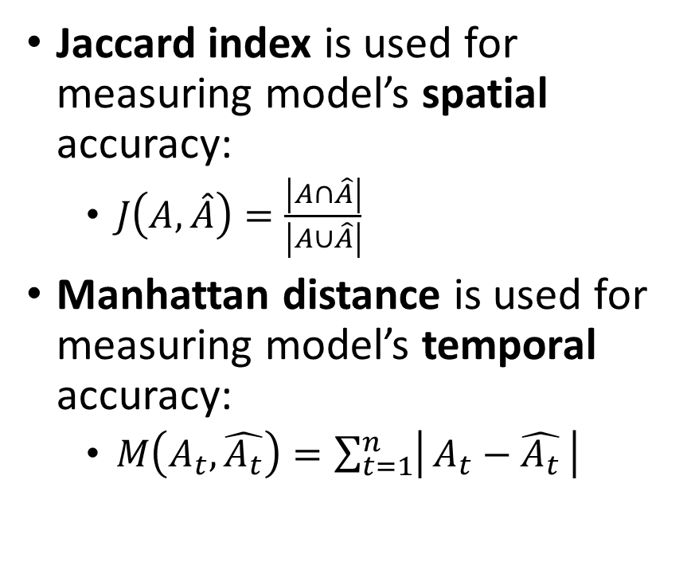
How model performs?
Jaccard index is used for measuring model’s spatial accuracy:
$J\left(A,\hat{A}\right)=\frac{\left|A∩\hat{A}\right|}{\left|A∪\hat{A}\right|}$
Manhattan distance is used for measuring model’s temporal accuracy:
$M\left(A_{t},\hat{A_{t}}\right)=\sum_{t=1}^{n}{\left| A_{t}−\hat{A_{t}} \right|}$

Slide 39
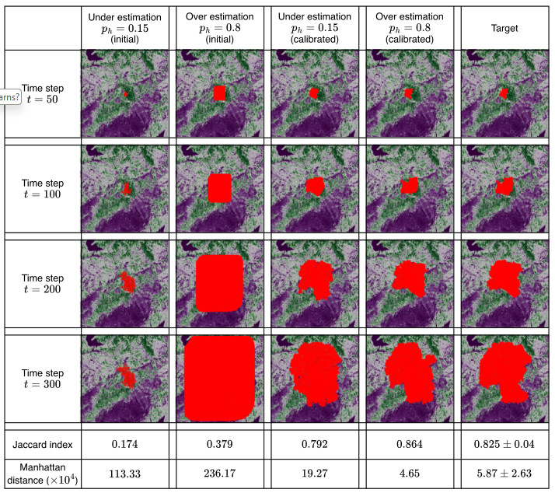
Simulation Results

Slide 40

Let’s run and check it!
Open this link: https://shorturl.at/t20fg
Or go to my repo directly: github.com/s-abdullaev/fire_sim_lecture
Click this button:

Slide 41
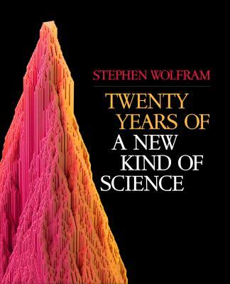
Further Reading
PyTorchFire paper:
https://arxiv.org/abs/2502.18738
DCA simulations:
https://distill.pub/2020/growing-ca
https://distill.pub/2020/selforg/mnist
https://ccl.northwestern.edu/netlogo
Other useful resources:
Stephen Wolfram’s book
https://www.wolframscience.com/nks
Universe as a Number:
https://unasanu.xyz/en/

